Slide 1

LINEAR CONTROL
SYSTEMS
Ali Karimpour
Assistant Professor
Ferdowsi University of Mashhad
Notes:
<<<1.1>>>
###Control System Design###
{{{Control, Design}}}

Slide 2
Lecture 13
Time domain analysis of control systems
Topics to be covered include:
Transient response of a prototype second order system
  Damping ratio and damping factor.
  Natural undamped frequency and damped frequency.
  Percent overshoot.
  Delay time, rise time and settling time.
Different reigns of S plane.
  Constant natural frequency loci.
  Constant natural damped frequency loci.
  Constant damping factor loci.
  Constant damping ratio loci.

Slide 3
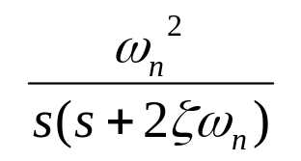
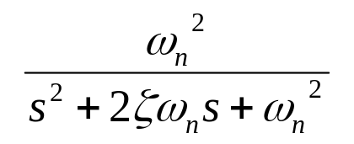
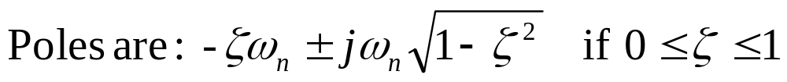
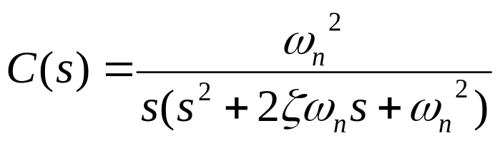
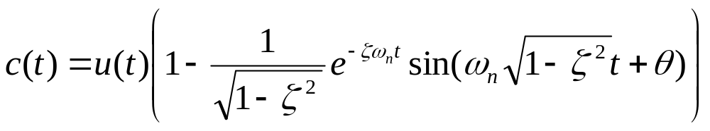

Introducing a prototype second order system.
معرفی یک سیستم نمونه درجه 2
+
e
r
c
r
c
-
Step
response

Slide 4






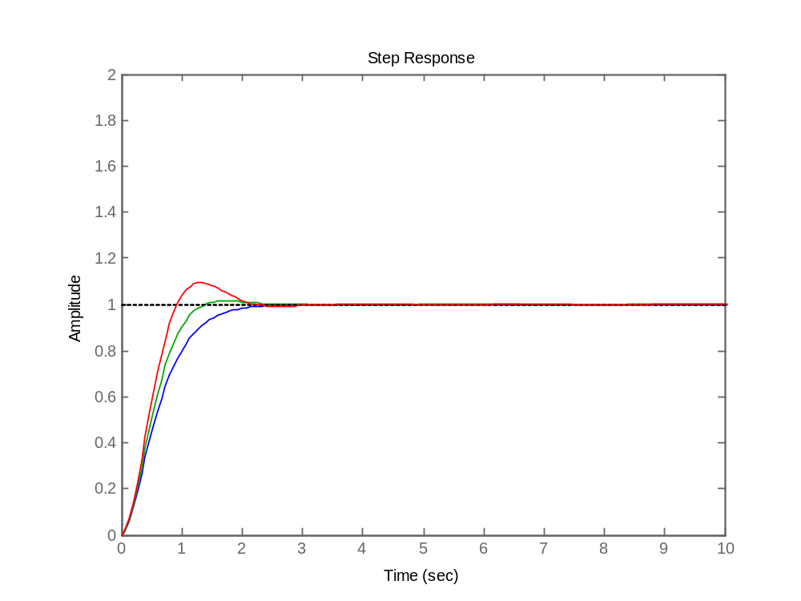
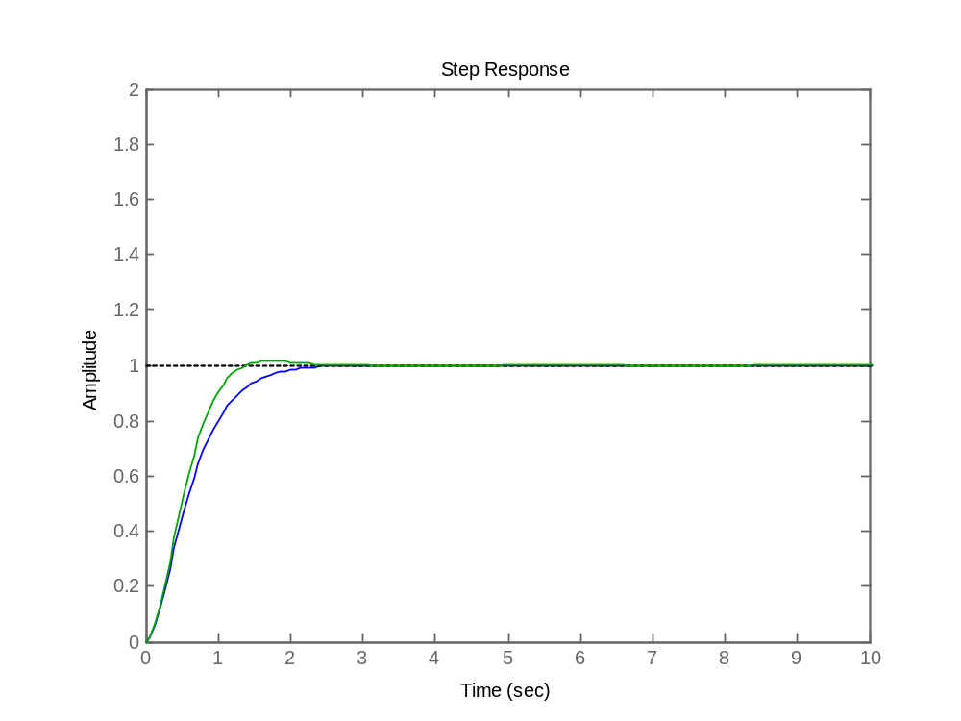
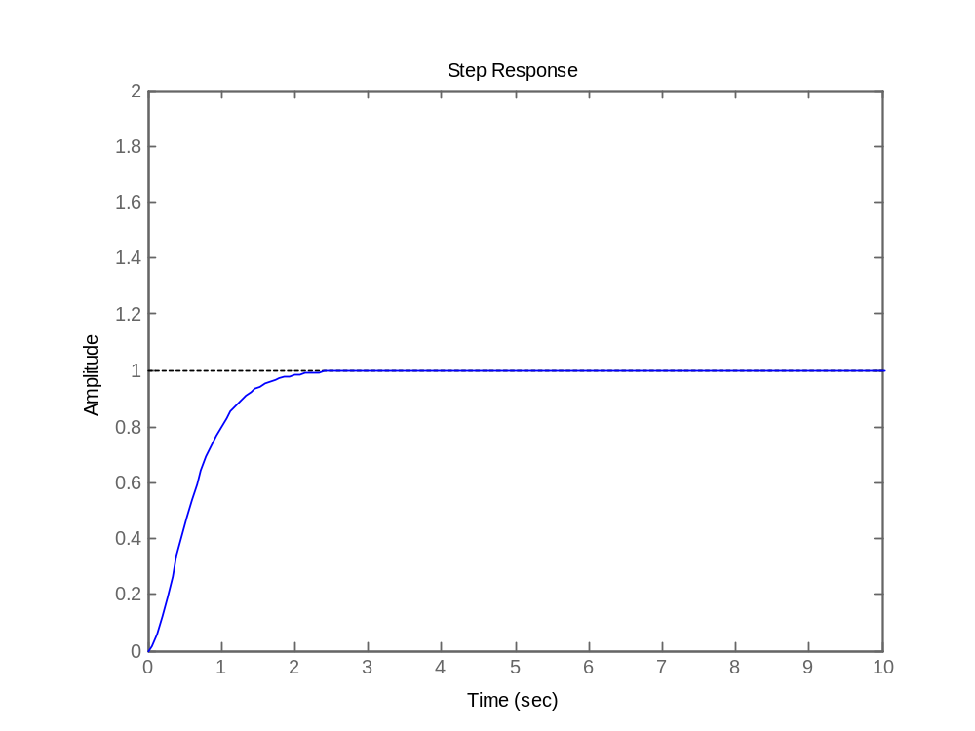
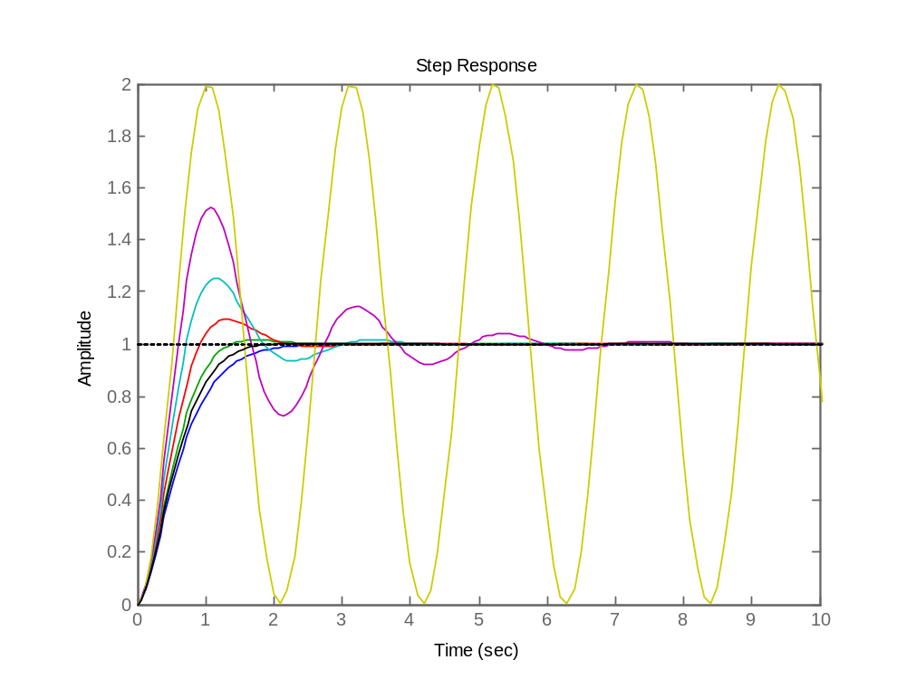
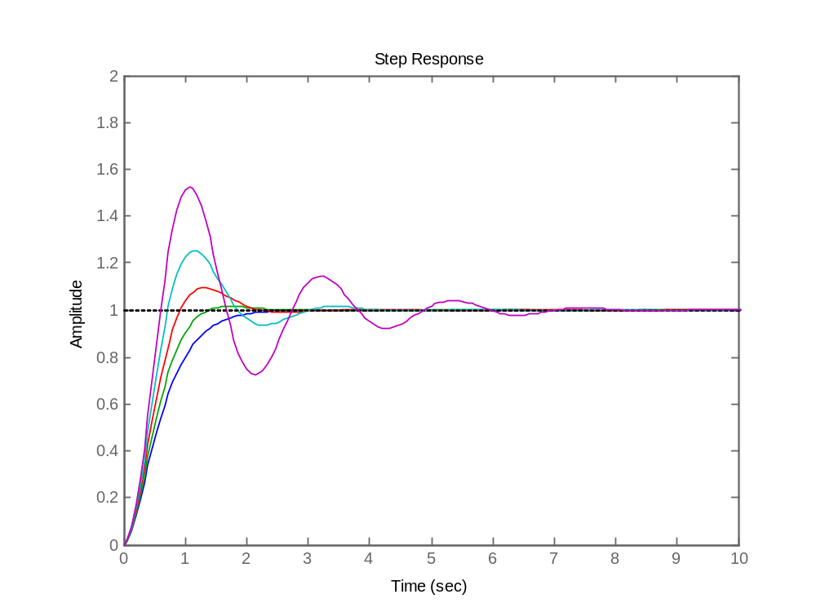
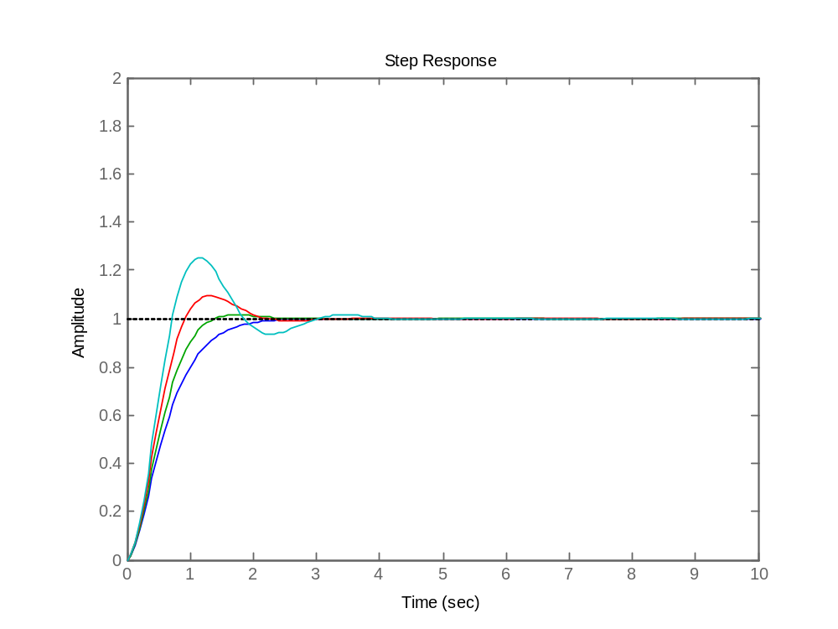
Step response
پاسخ پله
Notes:
<<<3.6>>>
###State Space Models###

Slide 5
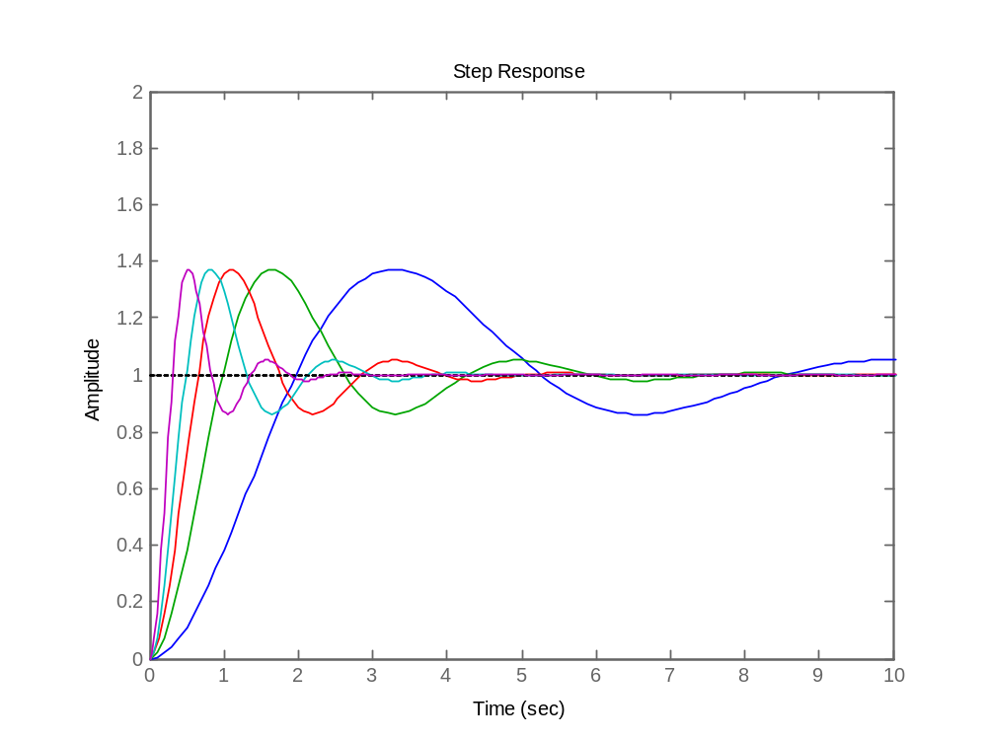
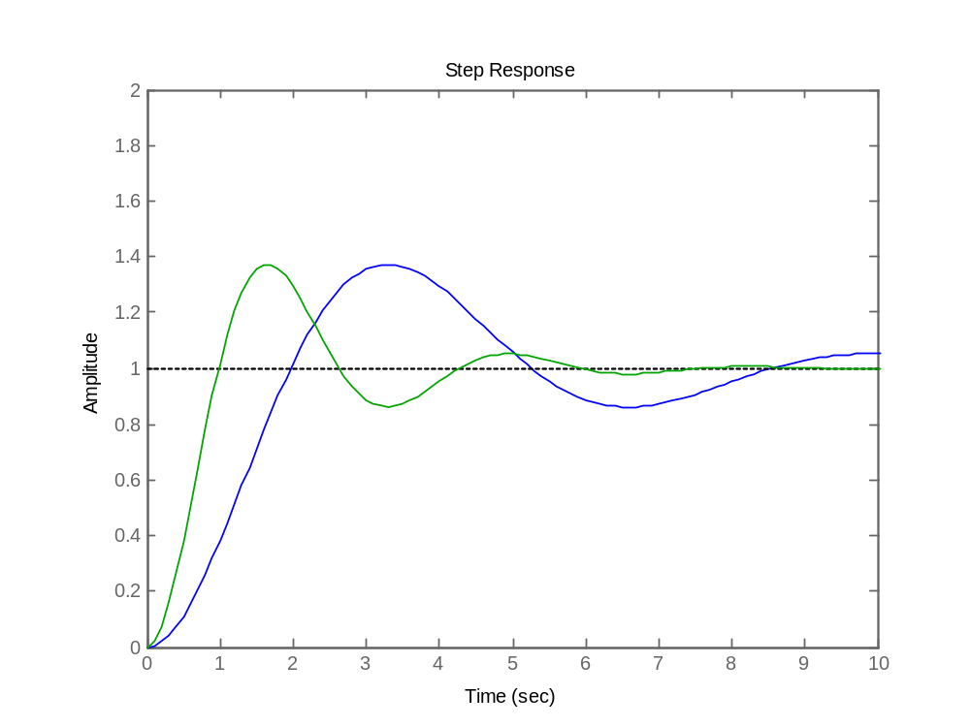
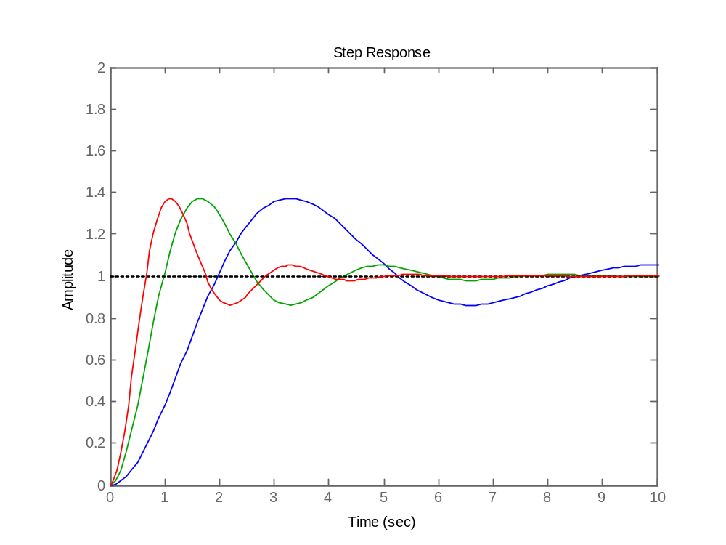
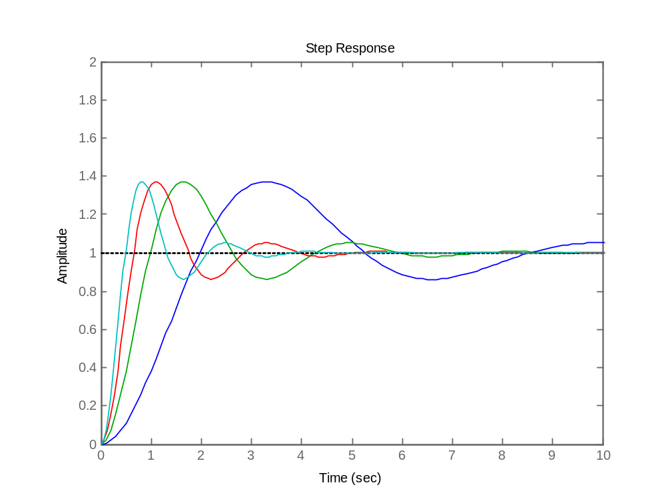
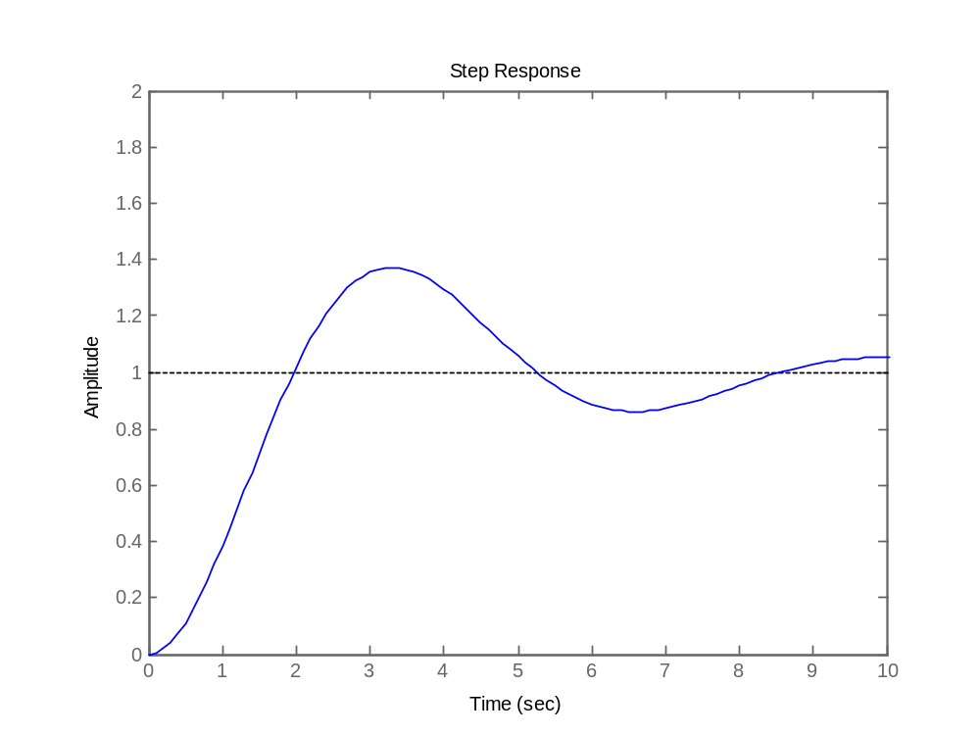
Step response
پاسخ پله
Notes:
<<<3.6>>>
###State Space Models###

Slide 6
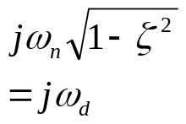





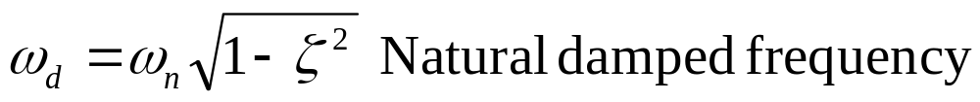

Introducing a prototype second order system.
معرفی یک سیستم نمونه درجه 2
+
e
r
c
r
c
-
فرکانس طبیعی
ضریب میرائی
نسبت میرائی
فرکانس طبیعی میرا شده

Slide 7
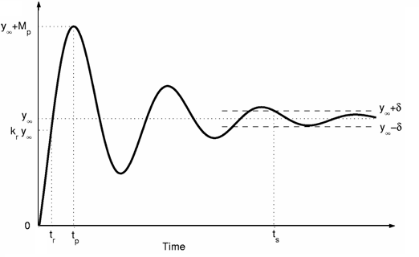
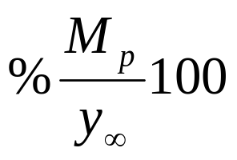

Percent Overshoot
درصد فراجهش
How can we find
P.O. ?
چگونه درصد فراجهش
را بیابیم؟

Slide 8
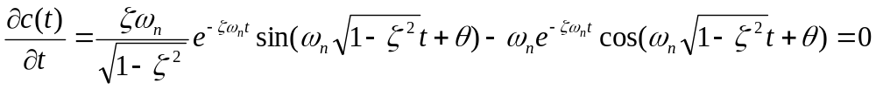
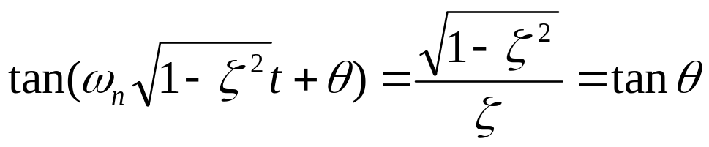
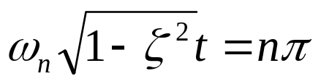
Calculation of Percent Overshoot and Peak Time
محاسبه درصد فراجهش و لحظه پیک

Slide 9
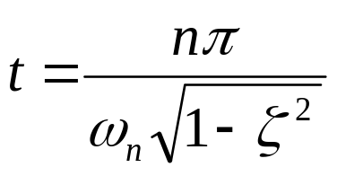
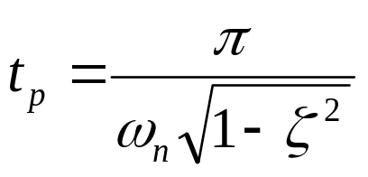
Peak time
لحظه پیک
Let n=1

Slide 10
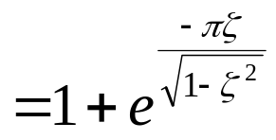
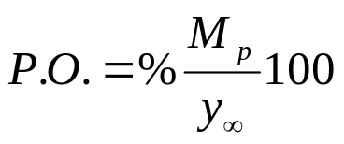
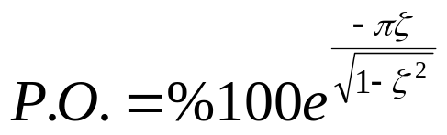
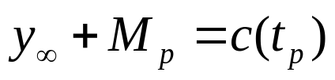
Calculation of Percent Overshoot
محاسبه درصد فراجهش

Slide 11
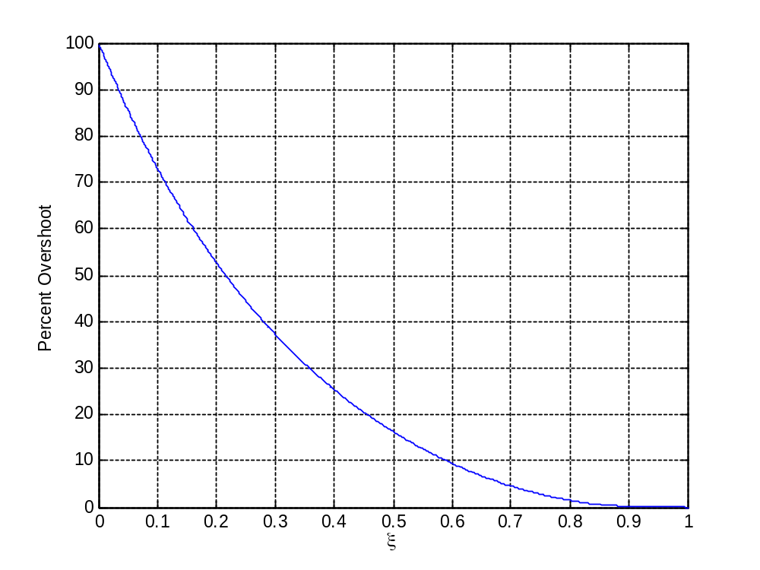


Percent Overshoot
درصد فراجهش
0 100%
0.100 73%
0.200 53%
0.300 37%
0.400 25%
0.500 16%
0.707 4.3%
1 0%

Slide 12

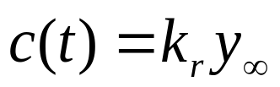
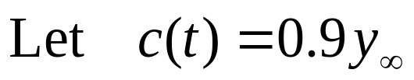
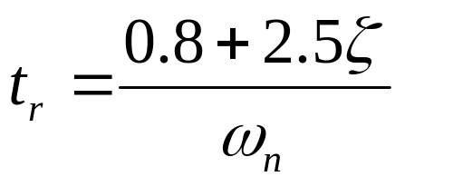
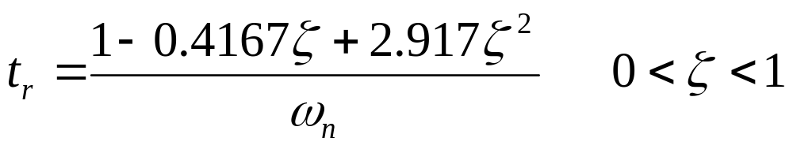
Rise time
زمان صعود
How can we find
rise time ?
چگونه زمان صعود
را بیابیم؟

Slide 13

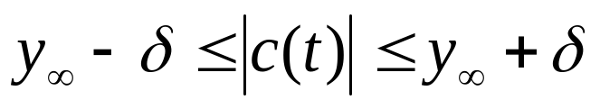
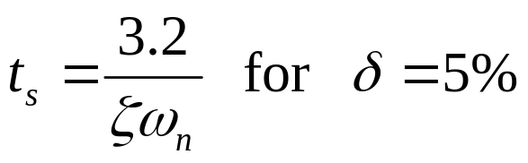
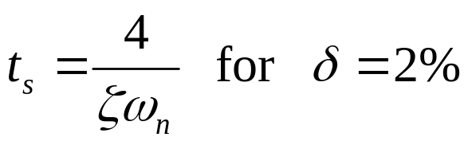

Settling time
زمان نشست
How can we find
settling time ?
چگونه زمان نشست
را بیابیم؟

Slide 14


Different reigns of S plane.
نواحی مختلف در صفحه S
Constant natural frequency loci.
Constant natural damped frequency loci.
Constant damping factor loci.
Constant damping ratio loci.

Slide 15


Constant natural frequency loci.
مکان فرکانس طبیعی ثابت
2
1

Slide 16


Constant natural damped frequency loci.
مکان فرکانس طبیعی میرا شده ثابت
2
1
-1
-2

Slide 17


Constant damping factor loci.
مکان ضریب میرائی ثابت

Slide 18
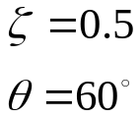
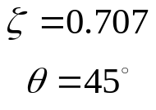
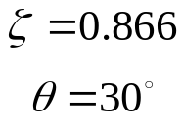
Constant damping ratio loci.
مکان نسبت میرائی ثابت

Slide 19



Example 1: Find the loci of a system where damping ratio is greater then 0.707 and damping factor greater than 2

Slide 20



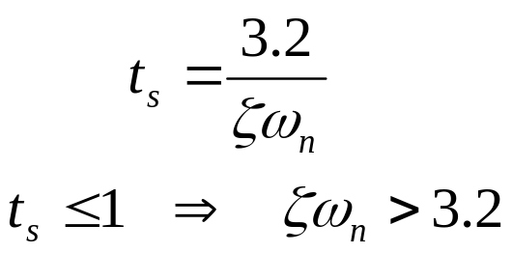


Example 2: Find the loci that the percent overshoot is less than 16% and settling time is less than 1 sec (according to 5% bound).

Slide 21












Effect of roots loci on step response
تاثیر مکان ریشه ها بر پاسخ پله
10
5
-5
-2.5
2.5
Conjugate root is not shown
ریشه مزدوج نشان داده نشده است

Slide 22
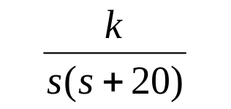
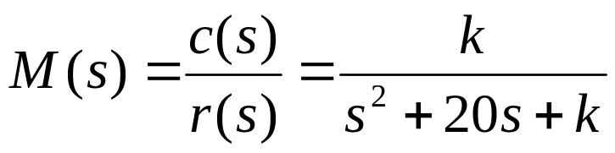



Example 3: Find the poles of the following systems and its corresponding step response for k=75, 100, 200 and 1000
+
e
r
c
-

Slide 23
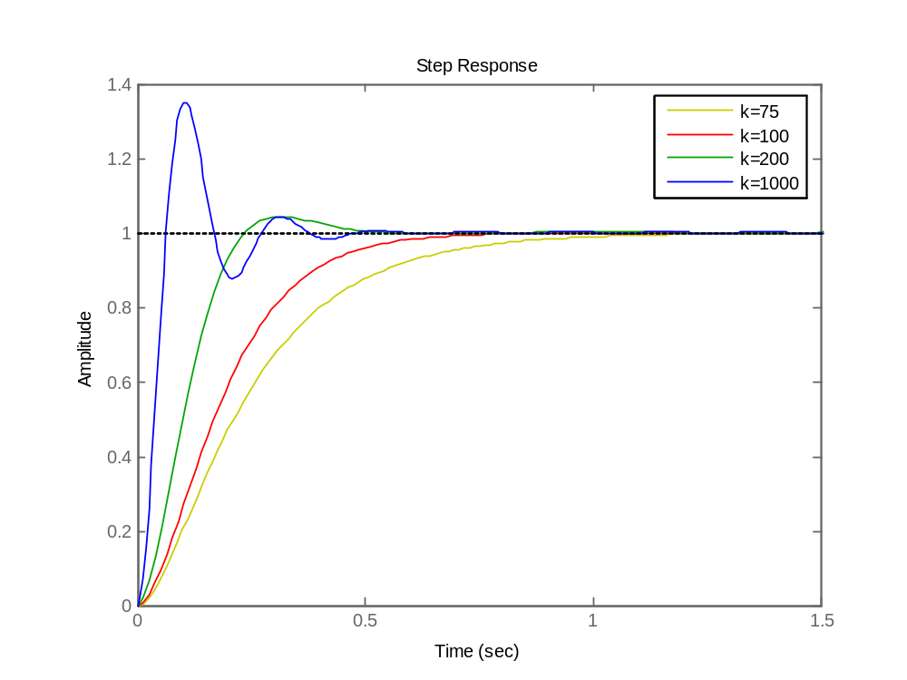
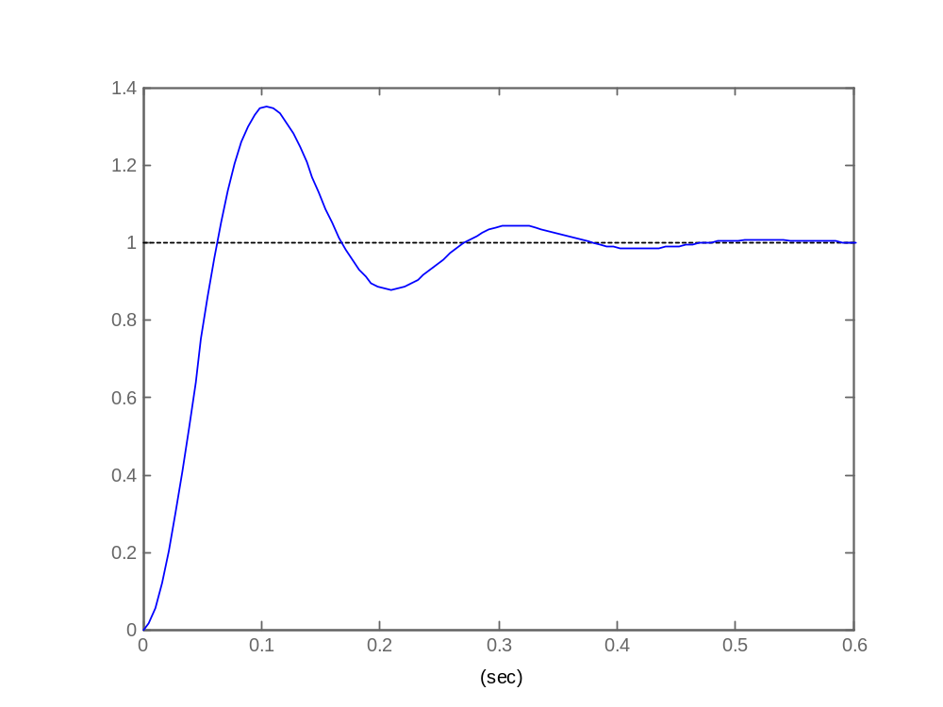
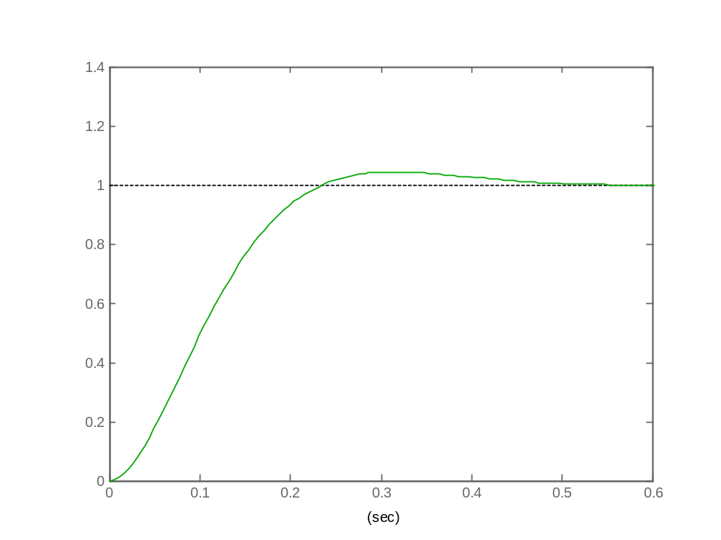
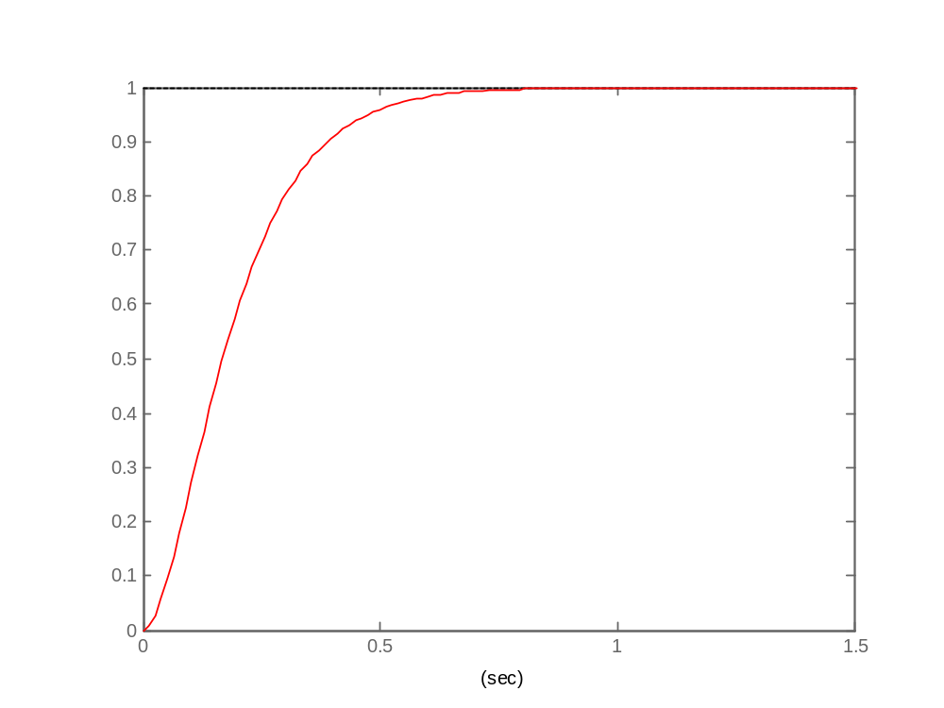
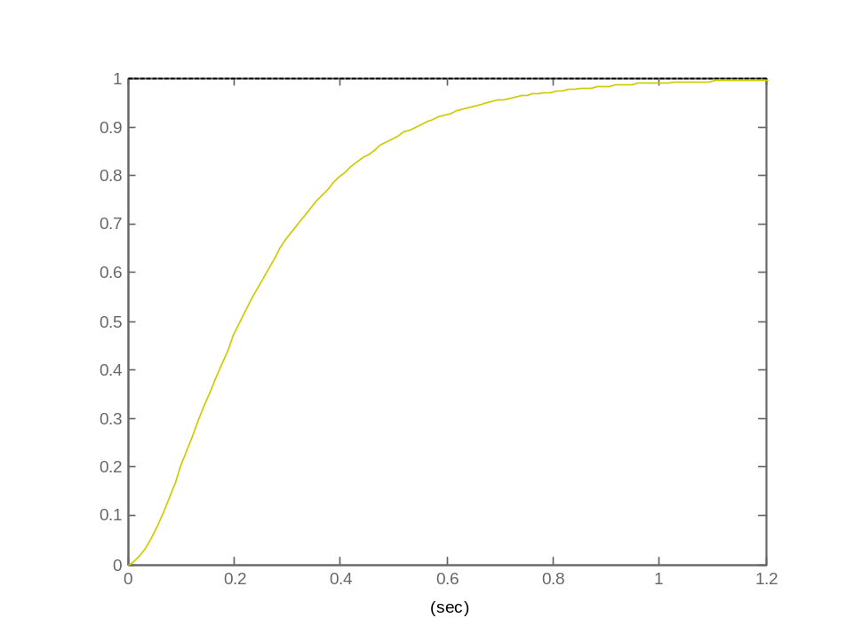
+
e
r
c
-
k=1000
k=200
k=75
k=100

Slide 24
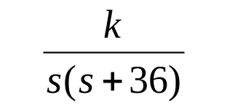
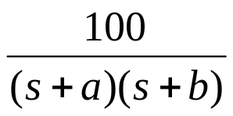
Exercises
تمرینها
1- In the following system set k such that the percent overshoot of system be 4.3%
+
e
r
c
-
2- In the following system set a and b such that the percent overshoot of system be 4.3%
And the steady state error to step input be 0.
+
e
r
c
-
3- In the system of problem 1 set k such that
The error to ramp input be 0.01
The percent overshoot of system be 4.3%
The error to ramp input be 0.01 and the percent overshoot of system be 4.3%
Notes:
<<<3.6>>>
###State Space Models###

Slide 25


Exercises
تمرینها
4- In the following system
For k=200 derive settling time, rise time and percent overshoot.
Confirm your result with step response.
b) For k=1000 derive settling time and percent overshoot.
Confirm your result with step response.
+
e
r
c
-
5- In the following system set the k such that the imaginary poles have 0.707 damping ratio.
+
e
r
c
-
Notes:
<<<3.6>>>
###State Space Models###

